Slide 1

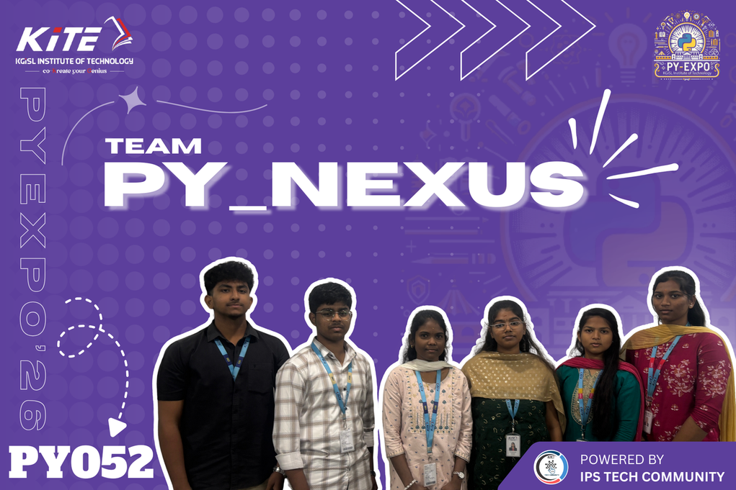





Team members :
1.Charumathi M
2.Nesavandana K R
3.Hashini S
4.Sudharsna S
5.Gurushunth A R
6.Dev venket S
Project Title:
PURE CHECK
Problem statement:
Milk is a widely consumed nutritious food, but it is often adulterated with water, detergent, starch, chemicals, and even steroids or hormones to increase profit, which can cause serious health issues. Traditional milk testing requires laboratories, chemicals, and skilled technicians, making it costly, slow, and difficult in rural areas. Therefore, a low-cost, portable, real-time milk quality monitoring system using sensors to measure pH, turbidity, TDS, color, and density is needed to quickly detect adulteration and ensure safe, pure milk for consumers.

